Slide 1

GICC 2013
Global Infrastructure Cooperation Conference
발주처 가이드 북 컨텐츠 시안
2013. 11. 8

Slide 2
GICC 2013
Global Infrastructure
Cooperation Conference
GICC 2013
Global Infrastructure
Cooperation Conference
1
2
Overview
Title : Global Infrastructure Cooperation Conference (GICC) 2013
Date : November 12(Tue) – 14(Thu) 2013
Venue : Lotte Hotel World, Seoul, Korea
Hosted by : Ministry of Land, Infrastructure and Transport (MOLIT)
Organized by : International Contractors Association of Korea (ICAK)
Daily Program
*Overseas project owners are not mandated to participate Korean Attaché & ADIC meetings.
*Please refer to page 7 for Floor Plan of the venue.
Project Seminar_ Day 1 (November 12)
Main Event
Date : November 12, 09:00-20:30
Venue : Crystal Ballroom (3F), Lotte Hotel World
-Please make sure to arrive at the venue ten minutes early (09:50) for the Opening Ceremony
Time | Day 1 Nov. 12(Tue) |  |  |  | Day 2 Nov. 13(Wed) |  |  |  | Day 3 Nov. 14(Thu)
09:00~09:30 | Registration |  |  |  |  |  | Korean Attaché Meeting (Emerald Room) | Project Opportunities with ADIC (Ruby&Jade Room) | Industrial site tour
 |  |  |  |  | Registration
09:30~10:00
10:00~10:40 | Opening Ceremony (Crystal Ballroom) |  |  |  | 1:1 Project Meeting (Crystal Ballroom) | MDB Private Sector Individual Project Meeting (Pearl/Topaz Room)
10:40~12:00 | Session I Introducing Korean Contractors’ Competitiveness and Government Support (Crystal Ballroom)
12:00~14:00 | Luncheon hosted by MOLIT (Emerald Room) |  |  |  | Lunch Buffet (Sapphire ballroom B1)
14:00~15:40 | Session II Project Presentation [different room by sectors] |  |  |  | 1:1 Project Meeting (Crystal Ballroom) | MDB Private Sector Individual Project Meeting (Pearl/Topaz Room) | Korean Attaché Meeting (Emerald Room) | –
 | Water Resource and Plant (Crystal Ballroom 1) | Transportation (Crystal Ballroom 2) | MDB (Crystal Ballroom 3) | Urban Development (Rudy &Jade Room)
15:40~16:00 | Coffee Break
16:00~18:00 | Water Resource and Plant (Crystal Ballroom 1) | Transportation (Crystal Ballroom 2) | MDB (Crystal Ballroom 3) | Urban Development (Rudy &Jade Room)
18:00-18:30 | Break
18:30~20:30 | Dinner hosted by ICAK (Emerald Room) |  |  |  | Dinner Buffet (Sapphire ballroom B1)
Time | Program |  |  |  | Speakers
09:00~10:00 | Registration
10:00~10:40 | Opening Ceremony (Crystal Ballroom) | Opening Speech |  |  | CHOI, Jae Duk Chairman, ICAK
 |  | Welcoming Remarks |  |  | SUH, Seoung Hwan Minister, MOLIT
 |  | Address in Reply |  |  | -
 |  | Moving Sand Art |  |  | -
10:40~12:00 | Session Ⅰ (Crystal Ballroom) | Keynote Speech |  |  | -
 |  | Overview & Competitiveness of Korean Contractors in the Global Construction Market |  |  | KANG, Sin Young ICAK
 |  | Reinforcing Global Cooperation and Connectivity in a Challenging Environment |  |  | WON, Byung-chul K-exim
 |  | A Brief Introduction on K-sure |  |  | LEE, Koung Rae K-sure
12:00~14:00 | Luncheon (Emerald Room) | Hosted by MOLIT Minister
14:00~15:40 | Session II | Water Resource and Plant (Crystal Ballroom 1) | Transportation (Crystal Ballroom 2) | MDB (Crystal Ballroom 3) |  | Urban Development (Rudy &Jade Room)
15:40~16:00 | Coffee Break
16:00~18:00 | Session II | Water Resource and Plant (Crystal Ballroom 1) | Transportation (Crystal Ballroom 2) | MDB (Crystal Ballroom 3) |  | Urban Development (Rudy &Jade Room)
18:30~20:30 | Dinner (Emerald Room) | Hosted by ICAK Chairman

Slide 3
GICC 2013
Global Infrastructure
Cooperation Conference
GICC 2013
Global Infrastructure
Cooperation Conference
Project Seminar_ Day 1 (November 12)
Afternoon Session II : Water Resource and Plant
Date/Time : November 12, 14:00-18:00
Venue : Crystal Ballroom 1 (3F)
3
Project Seminar_ Day 1 (November 12)
Afternoon Session II : Transportation
Date/Time : November 12, 14:00-18:00
Venue : Crystal Ballroom 2 (3F)
4
 | Country | Project Owner | Name | Project Name
1 | Costa Rica | Ministry of Environment and Energy (Ministerio de Ambiente y Energía) | Maria Guzman | Clean Energy Production in Costa Rica
2 | Philippines | Department of Energy | Jose Raymund Acol | Investment Opportunities in the Philippine Energy Sector
3 | Ethiopia | Ministry of Water and Energy | Tesfaye Fichala | Ethiopian Water Sector and Its Investment Opportunities
4 | Mexico | Comision Federal de Department Electricidad | Federico Lopez De Alba | Future development of electricity projects in Mexico, 2013-2026
5 | Azerbaijan | State Oil Company of Azerbaijn Republic(SOCAR) | Ruslan Latifov | SOCAR OGPC Project General presentation
6 | Kazakhstan | Samruk - Kazyna Invest LLP | Yernar Bilyalov | Investments opportunities with Samruk-Kazyna Sovereign Wealth Fund
7 | Algeria | Sonatrach | Abderrahmane Bouchelarem | Approvisionnement du Sud de l'Europe en Gaz Naturel
8 | Korea | Korea Water Resource Corporation | - | -
 | Country | Project Owner | Name | Project Name
1 | Peru | Peruvian Embassy in Korea | Jamie Pomareda | Peru Investing in Infrastructure
2 | India | Dedicated Freight Corridor Corporation of India Limited (DFCCIL) | Ram Kumar Gupta | Dedicated Freight Corridors - Project and Opportunities
3 | Georgia | Ministry of Regional Development and Infrastructure of Georgia | George Amashukeli | Road Sector Development in Georgia
4 | Morocco | ADM | Hassane Boufous | Highways of Morocco / Presentation and activities
5 | Kazakhstan | Ministry of Transport and Communications of the Republic of Kazakhstan | Ruslan Tauyekelov | The applying of public-private partnership in the realization of projects in the railway industry
6 | Russia | Ministry of Transport | Oleg Vladimirovich Stupnikov | Public-Private Partnerships in Roads & Highways
7 | Azerbaijan | Ministry of Transport | Nazim Ismaylov | The Perspectives for the Development of the Transport Infrastructure in the Republic of Azerbaijan and Investment Projects
8 | Ethiopia | Ethiopian Roads Authority | Yetimgeta Asrat Maru | The Road Sector of Ethiopia (Performance and Opportunities)
9 | Turkey | Ministry of Transport, Maritime Affairs and Communications | Bekir Gezer | Transport Infrastructure in TURKEY’s 2023 Vision
10 | Korea | Korail/Korea Rail Network Authority/Korea Expressway Corp. | - | -

Slide 4
GICC 2013
Global Infrastructure
Cooperation Conference
GICC 2013
Global Infrastructure
Cooperation Conference
Project Seminar_ Day 1 (November 12)
Afternoon Session II : MDB Private Sector Infrastructure Development Seminar
Date/Time : November 12, 14:00-18:00
Venue : Crystal Ballroom 3 (3F)
5
Project Seminar_ Day 1 (November 12)
Afternoon Session II : Urban Development
Date/Time : November 12, 14:00-18:00
Venue : Rudy & Jade Room (3F)
6
 | Country | Project Owner | Name | Project Name
1 | Venezuela | Development Bank of Latin America | Germán Rios | CAF Development Bank of Latin America´s Approach for Infrastructure Financing
2 | USA | Multilateral Investment Guarantee Agency | Junglim Hahm | -
3 | Hong Kong | International Finance Corporation | Erik Ivo Becker | Partnering with the IFC
4 | Philippines | Asian Development Bank | Hisaka Kimura | Private Sector Infrastructure Finance
5 | Tunisia | African Development Bank | Mam-Tut Wadda-Senghore | AfDB Public Sector Transport & ICT Operations
6 | USA | Inter-American Development Bank | Weon-Kyoung Jo | The Infrastructure Market in LAC & IDB’s role
 | Country | Project Owner | Name | Project Name
1 | Tanzania | Ministry for Lands and Human Settlements Development | Alphayo Kidata | Kigamboni Investment Opportunities
2 | Kazakhstan | "NC "Astana EXPO-2017" JSC | Kazhymurat Ussenov | Astana EXPO-2017
3 | Indonesia | Ministry of Transportation, DGCA | Budi Prasetyo | Airport Development in Indonesia
4 | Philippines | Department of Transportation and Communications | Felicisimo Pangilinan Jr. | Philippine Transport Development Initiative And Its Prospect
5 | Nicaragua | The Ministry of Transport and Infrastructure | Wilfredo Valle | Road Investment Program
6 | Nepal | Ministry of Physical Planning, Works and Transport Management | Chandra Bahadur Shrestha | Nepal's quest to link India with China
7 | Myanmar | Yangon City Development Committee | Bo Htay | Infrastructure Development Plans of Yangon City
8 | Iraq | National Investment Commission | Gazanfer Semin Jaafar Al-Baeti | BNCP BISMAYA NEW CITY PROJECT
9 | UAE | Western Region Development Council | Mohamed Saeed Al Dhuhoori | -
10 | UAE | Abu Dhabi Urban Planning Council | Ahmed Al Shaikh Al Zaabi | -
11 | China | People's Government of Huanggu district, Shenyang | Li Pengyu | Introduction of Huanggu District
12 | Korea | Korea Land&Housing Corp./ Incheon Airport/ Korea Airports Corps. | - | Newtown Development Process and Techniques Your Reliable Partner Incheon International Airport Creative Airport Solution Provider

Slide 5
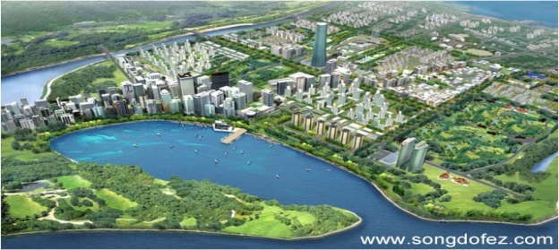
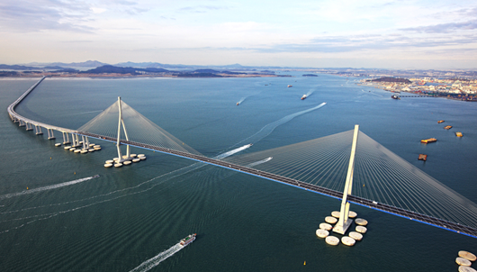
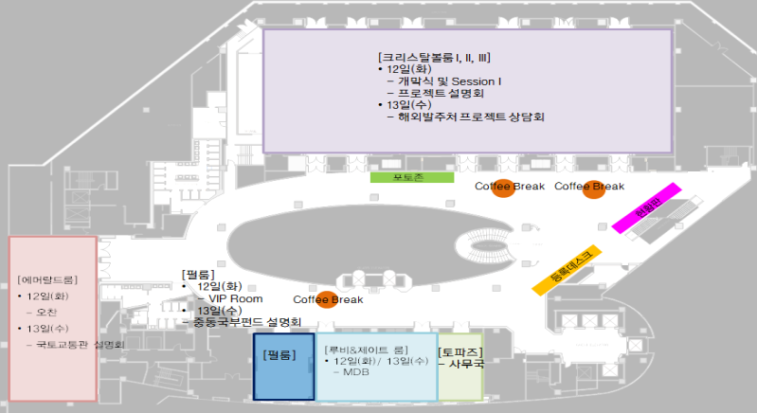
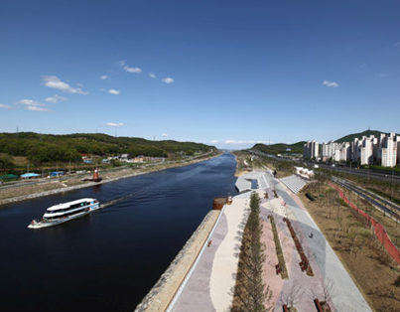
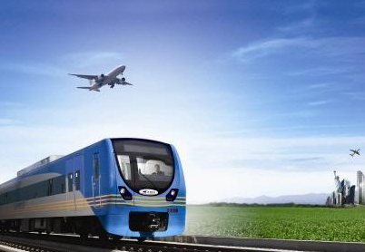
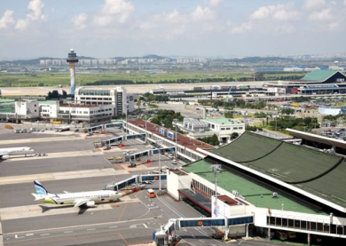
GICC 2013
Global Infrastructure
Cooperation Conference
GICC 2013
Global Infrastructure
Cooperation Conference
Project Meeting_ Day 2 (November 13)
Individual project meeting between pre-registered Korean contractors and overseas project owners
Date/Time : November 13, 09:30-18:00
Venue : Crystal Ballroom (3F)
7
VIP Delegation Tour_ Day 3 (November 14)
Date/Time : November 14, 08:00-20:00
Venue : Tour Lounge (2F)
Schedule :
Registration 08:00~08:30
Departure from Hotel 08:40
Incheon Free Economic Zone - Songdo Tour ① 10:00~10:30
Incheon Bridge Tour ② 11:00~11:30
Lunch 11:50~12:40
Gyeongin Ara Water Way (Ararium) Tour ③ 13:10~13:40
Airport Railroad Express(AREX) Tour ④ 13:55~14:10
Gimpo Airport Tour ⑤ 14:10~15:00
GyeongBokGung Palace Tour 16:00~17:00
N-Tower Tour & Dinner 17:30~19:00
Arrival at Hotel 20:00
*VIP Delegation Tour–initially divided by five different sectors–was integrated into one course.
*Please be advised that only pre-registered overseas project owners can participate and his/her delegation can be accompanied. Also, please bring your ID card from GICC to VIP Delegation Tour.
*GICC’s official program ends with Day 3 site tour; however, participants are free to leave after Day 2 based upon availability.
*Accommodation is provided for a maximum of four nights.
8
Time | Program
09:00~09:30 |  |  | Korean Attaché Presentation (Emerald Room) | Project Opportunities with ADIC (Ruby&Jade Room)
09:30~12:00 | 1:1 Project Meeting (Crystal Ballroom) | MDB Private Sector Individual Project Meeting (Pearl/Topaz Room)
12:00~14:00 | Lunch - Buffet (Sapphire ballroom, B1)
14:00~18:00 | 1:1 Project Meeting (Crystal Ballroom) | MDB Private Sector Individual Project Meeting (Pearl/Topaz Room) | Korean Attaché Presentation (Emerald Room) | -
*For those who are not comfortable with English, interpretation will be provided. (Russian, Spanish, and French)
*Pre-registered Korean contractors will come to your table for a project meeting; meeting with each contractor is 30 minutes-long.
Site Plan 3F
▶ Crystal Ballroom
-Opening ceremony (Day1)
-Project Presentation
-1:1 Project Meeting (Day2)
▶ Emerald Room
-Lunch/Dinner (Day1)
-Korea Attaché Meeting (Day2)
▶ Ruby&Jade Room
-Project Presentation (Day1)
-ADIC Project Seminar (Day2)
▶ Pearl/Topaz Room
-MDB Private Sector Individual
-Project Meeting (Day2)
① Incheon Free Economic Zone(IFEZ) - Songdo
② Incheon Bridge
③ Gyeongin Ara Water Way
④ Airport Railroad Express(AREX)
⑤ Gimpo Airport

Slide 6
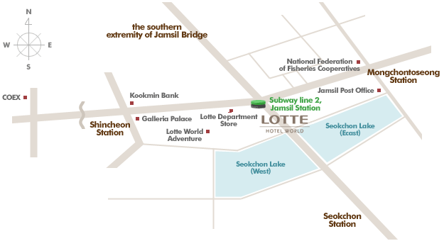
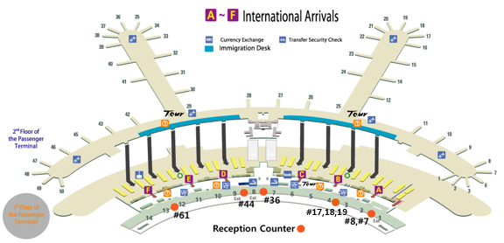
GICC 2013
Global Infrastructure
Cooperation Conference
GICC 2013
Global Infrastructure
Cooperation Conference
9
Accommodation (Lotte Hotel World)
Lotte Hotel World
-Tel : +82-2-419-7000
-Fax : +92-2-417-3655
-Address : (138-220) 240, Olympic-ro, Songpa-Gu, Seoul, Korea
-E-mail : Worldroom@hotellotte.co.kr
-Website : http://www.lottehotelworld.co.kr
-GICC staff will help you check-in.
-Expenses for minibar, room service, laundry service and telephone use will be charged for participant to pay
when check out.
-Also your credit card information will be required when check in. Check-in begins at 2 PM (3 PM for
character Room) and check-out is until 12 PM Noon. You can check-in on the 28th floor from 6:30 AM to
10 PM. Except that time, you can access to the front desk.
Meal Plan
10
General Information
Pick-up Service at the Incheon International Airport
-GICC 2013 staff will be waiting at the gate holding a welcoming card with conference title and
will guide you to the bus stop for your Airport Limousine Bus which will take your to the hotel.
- In case you miss our staff, go to the Information Desk, booth #36 on the first floor.
Limousine Bus Information
-Incheon International Airport → Lotte Hotel World, Jamsil
-Bus Stop : 4B or 11A (1st Floor)
-Route Name (Bus No.) : Jamsil 6705, 4705
-Interval : 15-20mins
-Travel Time : 90mins
-Lotte Hotel World is not the final destination of this bus. In order for you to make sure getting off at Lotte Hotel World, GICC staff will be waiting for you at the Lotte Hotel World bus stop.
Type |  | Nov. 12 | Nov. 13 | Nov. 14 | Nov. 15
Breakfast (6:30~10:00) | Style | Hotel Buffet | Hotel Buffet | Hotel Buffet | Hotel Buffet
 | Venue | Club Lounge (28F) | Club Lounge (28F) | Club Lounge (28F) | Club Lounge (28F)
Lunch (12:00~13:00) | Style | Western Food | Buffet | Included in site tour
 | Venue | Emerald Room (3F) | Sapphire Ballroom (B1)
Dinner | Style | Korean Food | Buffet
 | Venue | Emerald Room (3F) | Sapphire Ballroom (B1)
*For those who arrive on Nov. 11, please feel free to visit any restaurants in Lotte Hotel World; GICC will cover meal expenses for which were ordered by GICC guest room numbers on the 11th.

Slide 7
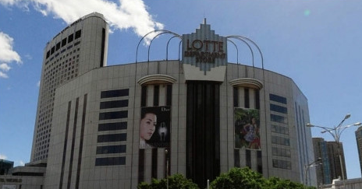
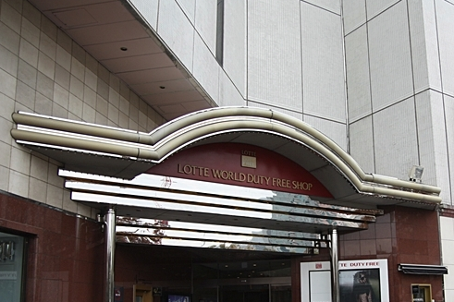
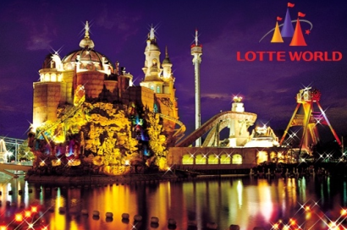
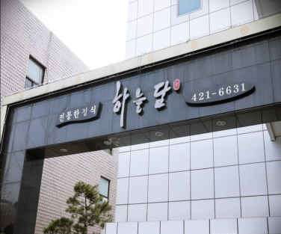
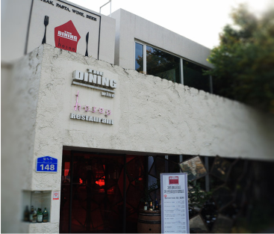
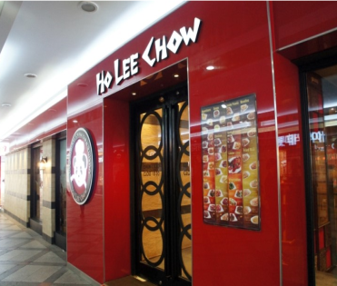
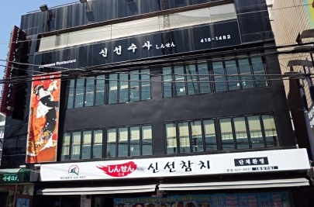
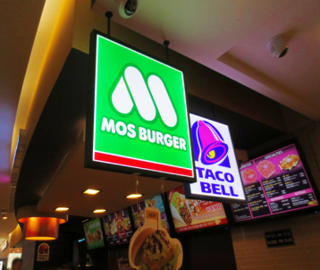
GICC 2013
Global Infrastructure
Cooperation Conference
GICC 2013
Global Infrastructure
Cooperation Conference
Check-out
When checking out, please take boarding pass for Airport Limousine Bus at the Lotte Hotel World front desk on 28 Floor. Also, please leave the questionnaire in your room when checking out.
Other Information
To call a Taxi
To take a taxi for your own personal schedule, please come and ask for a call taxi at the Concierge desk
Shopping & 어드벤쳐 Information
Lotte Hotel is located near Lotte Department Store, Lotte Duty Free (10F), Lotte World.
Tourist Information
For Tourist information, sightseeing and attractions, please visit the website at ;
Contact Information
Please contact any of our staff below when leaving GICC site for your individual plans.
Hotel : Mi-Hyeon Ahn/ +82-2-411-7547
Emergency : Jessica Jo/ +82-10-9677-9865
Travel Agency : +82-2-771-7100
ICAK: Sung-Jin Kim 010-6620-5995
Jeongjin Oh/ +82-10-4087-5433
11
List of Restaurants near Lotte Hotel World
12
Name | Type | Location | Contact No. | Open & close
HANULDAM | Korean Food | ChangDae Building B1, Samjeon-Dong, Songpa-Gu | +82-2-421-6631 | 11:30~15:00 17:00~22:00
THE DINING HOSOO | European Food | Jamsil-Dong 47, Songpa-Gu (Right in front of Lotte Hotel) | +82-2-2042-7544 | 11:30~23:00
HO LEE CHOW | Chinese Food | Jamsil-Dong 40-1, Songpa-Gu Lotte World 1 Floor | +82-2-411-0688 | 11:30~10:30
SINSUNSOOSA | Japanese Food | Bangi-Dong 43-7, Songpa-Gu, | +82-2-415-1482 | 11:00~24:00
MOS BURGER | Fast Food | Jamsil-Dong 40-1, Songpa-Gu Lotte Department store B1 Floor | +82-2-2143-1825 | 10:30~20:00
TACO BELL |  |  | +82-2143-1788
Korea Tourism Organization | http://english.visitkorea.or.kr
Lonely Planet Seoul | http://www.lonelyplanet.com/south-korea/seoul
HANULDAM – Korean Food
THE DINING HOSOO
– European Food
HO LEE CHOW – Chinese Food
中文 : 崔美同 +82-10-7510-7234
Español : Felipe Sungwon Jung +82-10-6666-9764
Русский язык : Цай Любовь +82-10-2906-6150
SINSUNSOOSA – Japanese Food
MOS BURGER & TACOBELL – Fast Food

Slide 8
GICC 2013
Global Infrastructure
Cooperation Conference
GICC 2013
Global Infrastructure
Cooperation Conference
CURRENCY AND EXCHANGE RATE
The basic unit of the Korean monetary system is the “Korean Won” (KRW). Notes and coins of various denominations are used: 1,000, 5,000, and 10,000 notes and 10, 100, and 500 coins. The exchange rate is subject to market fluctuation. The US$ to KRW exchange rate as of October 28 2013 is approximately 1$ =1,062 KRW.
Fare
Subway: KRW 1,150 basic fare
Taxi: KRW 3,000 basic fare within 2km
Taxi is charged by the meter and the drivers do not expect to receive a tip. Most of the taxis operating in Seoul area accept credit cards or even pre-paid public transportation cards. Note this in mind and make sure to have some cash (in KWR) with you if you plan to use a cab in provincial cities. Basic fare can slightly vary from region to region.
Public Metro Bus: KRW 1,150 basic fare(local), KRW 1,950 basic fare(express)
Additional charges apply by car mileage and running time.
MOBILE TELECOMMUNICATION IN KOREA
Your ability to use your own mobile phone or smart phone in Korea depends on what kind of network you are using. Delegates are advised to check with their service operators about the roaming compatibility. Local mobile telecommunication service providers offer phone rental services and some handsets also support GSM SIM roaming. These service providers have rental outlets at the Incheon International Airport. For more information and reservation, please visit Tour2Korea (the official Korea Tourism Organization site).
INTERNATIONAL CALLS
To make an international call, first dial the international access code 001, 002 or 008, followed by the country code, area code and the individual number.
EMERGENCY CALLS
Police: 112
Fire Department: 119
Ambulance: 119
13
CLIMATE
The Republic of Korea lies in the temperate zone with four distinct seasons. Geographically, it is located in the middle latitudes of the Northern Hemisphere, on the east coast of the Eurasian Continent and also adjacent to the Western Pacific. It shows, therefore complex climate characteristics which reveal both continental and oceanic features. It has a wide temperature difference between summer and winter and much precipitation in comparison with that of the Continent. Also, it has distinct monsoon wind, a rainy period from the East-Asian Monsoon locally called "Changma", typhoon, and while often heavy snowfalls in winter. It belongs to a relatively wet region due to much more precipitation than that of the world average.
(Source: Korea Meteorological Administration)
LANGAUGE
The Korean language belongs to the Ural-Altaic language group. Han-geul, the Korean alphabet, is composed of 10 simple vowels and 14 consonants. In 1443, King Sejong promoted the creation of an alphabet for writing that could simply and accurately convey the sounds of the spoken language. Originally known as Hunminjeongeum, or "the correct sounds for the instruction of the people," it is an easy-to-learn phonetic alphabet that enabled the common people to express themselves in writing.
RELIGION
Freedom of religion is fully guaranteed in the Republic of Korea. There are four broad streams of influence: Shamanism, Buddhism, Confucianism, and Christianity. Christianity has had a large following in Korea since its introduction from the West in the late 18th century. Catholicism and Protestantism have significantly grown under the influence of Europe and the United States. There are also various minor religions based on various combinations of elements from traditional religions.
TIME ZONE ELECTRICAL VOLTAGE
GMT +9 hours 220V
14
Nov. 11 | Nov. 12 | Nov. 13 | Nov. 14 | Nov. 15
Low 2 ℃ High 10 ℃ | Low 1 ℃ High 11 ℃ | Low 2 ℃ High 12 ℃ | Low 4 ℃ High 13 ℃ | Low 5 ℃ High 13 ℃

